Slide 1
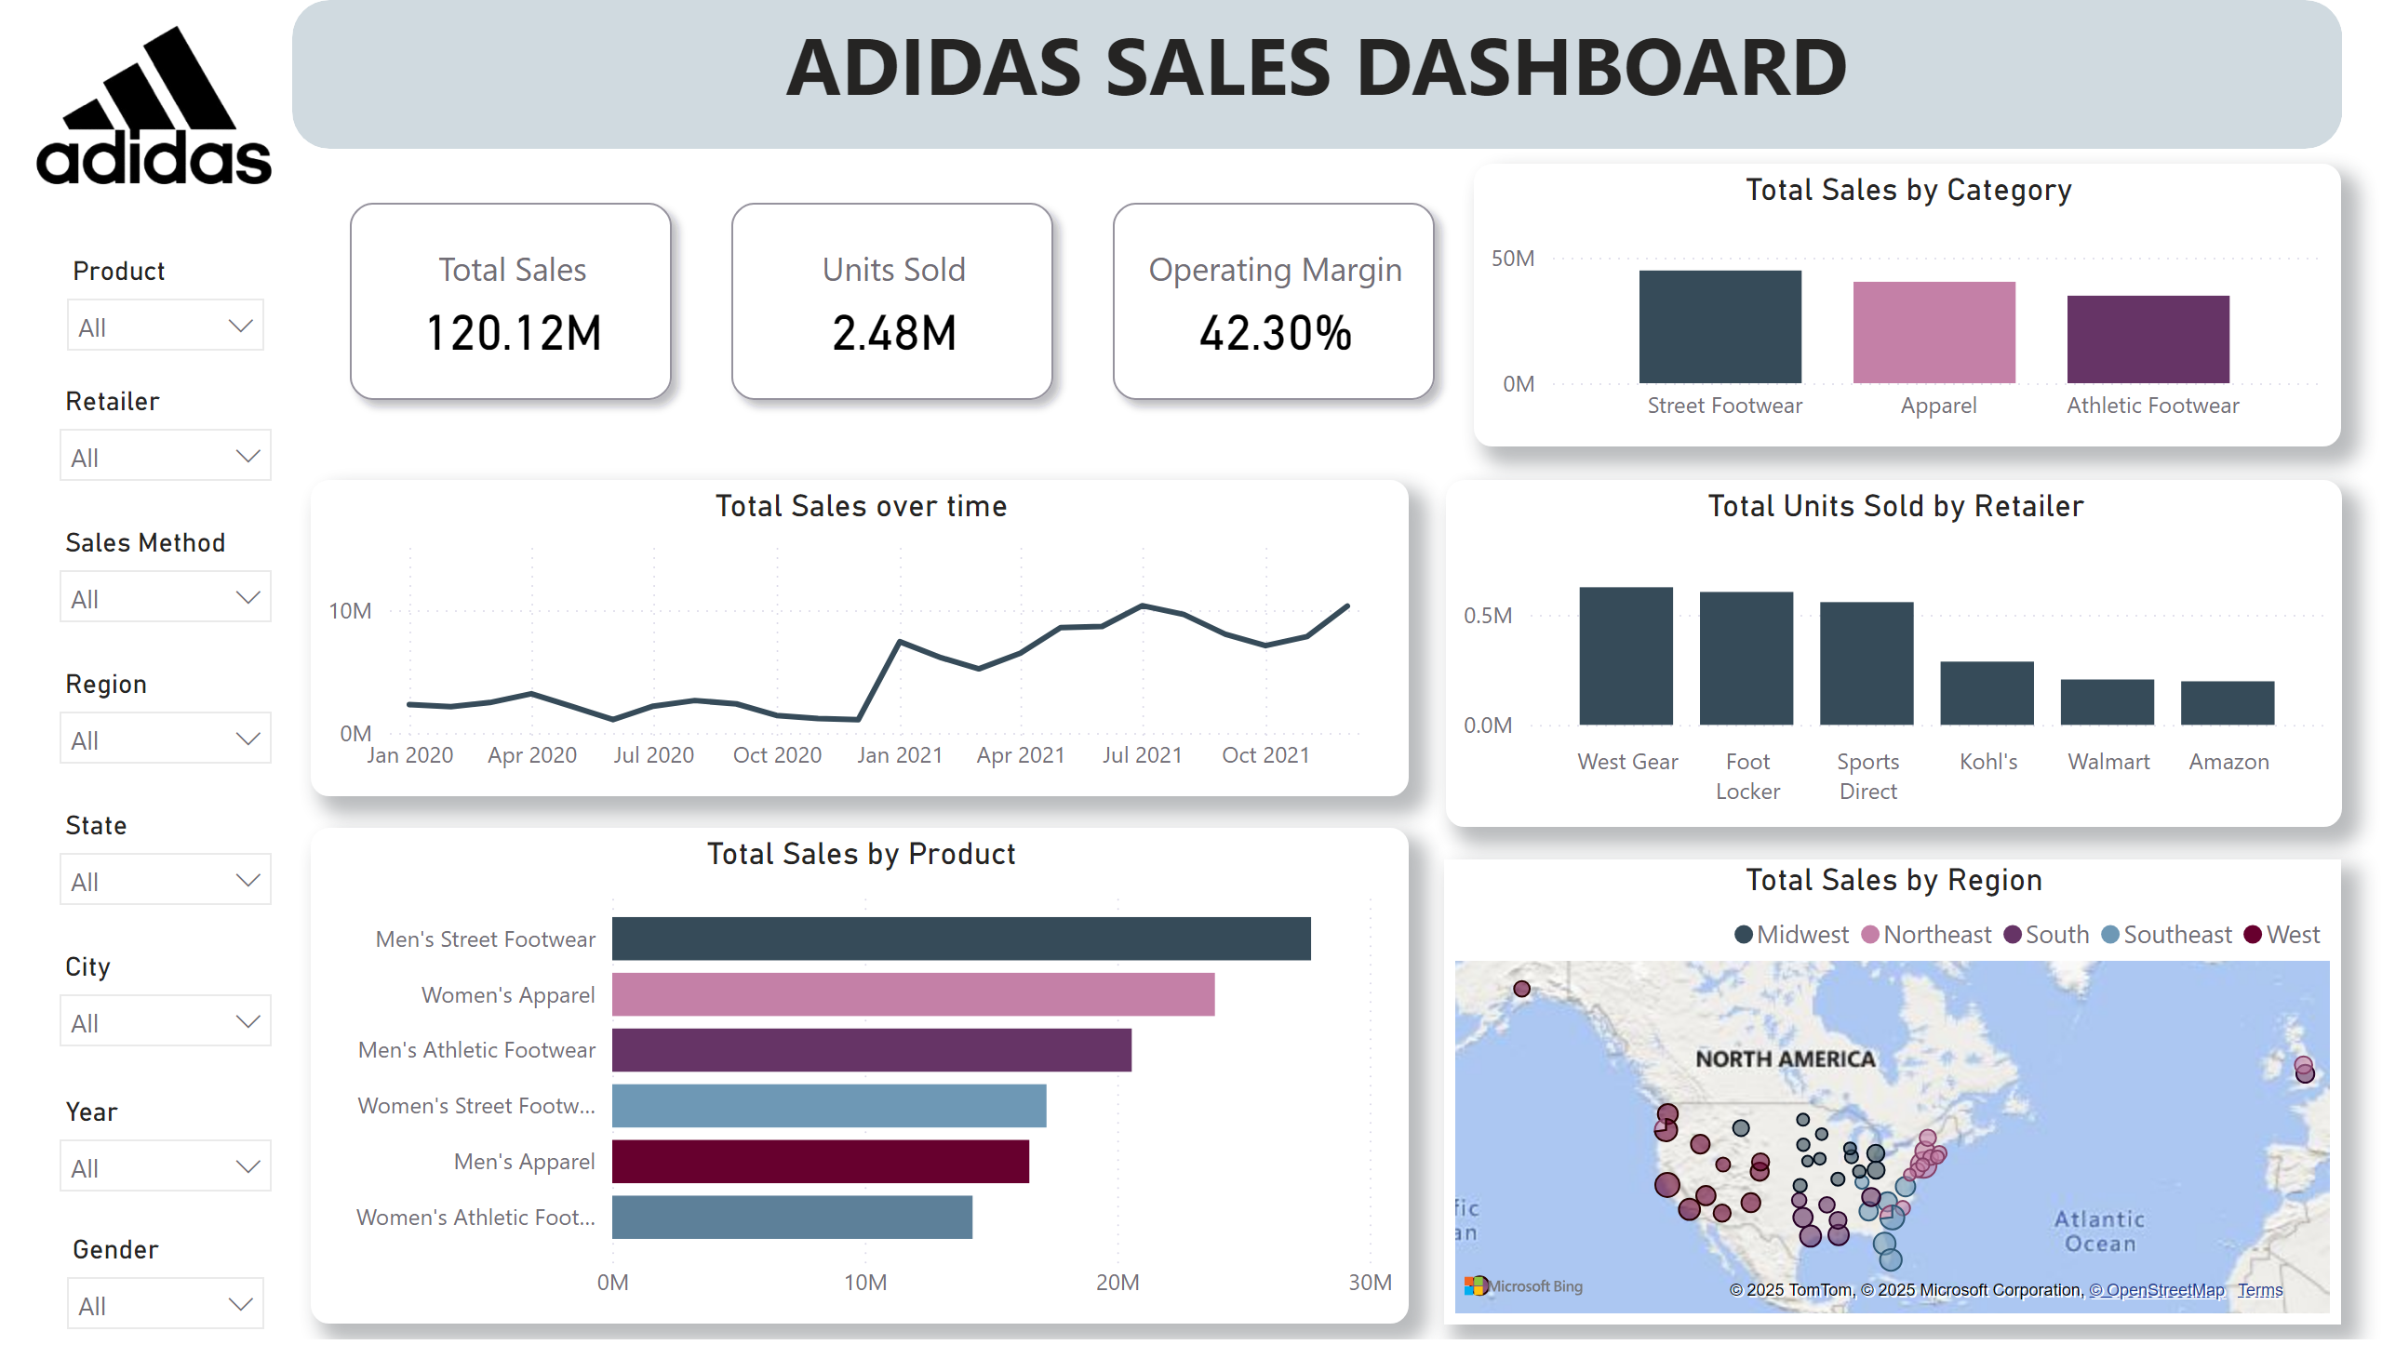
Sales Performance
Notes:
slicer
No alt text provided
slicer
No alt text provided
slicer
No alt text provided
slicer
No alt text provided
slicer
No alt text provided
slicer
No alt text provided
slicer
No alt text provided
slicer
No alt text provided
cardVisual
No alt text provided
image
No alt text provided
shape
No alt text provided
textbox
No alt text provided
Total Sales over time
No alt text provided
Total Sales by Category
No alt text provided
Total Units Sold by Retailer
No alt text provided
Total Sales by Product
No alt text provided
Total Sales by Region
No alt text provided

Slide 2
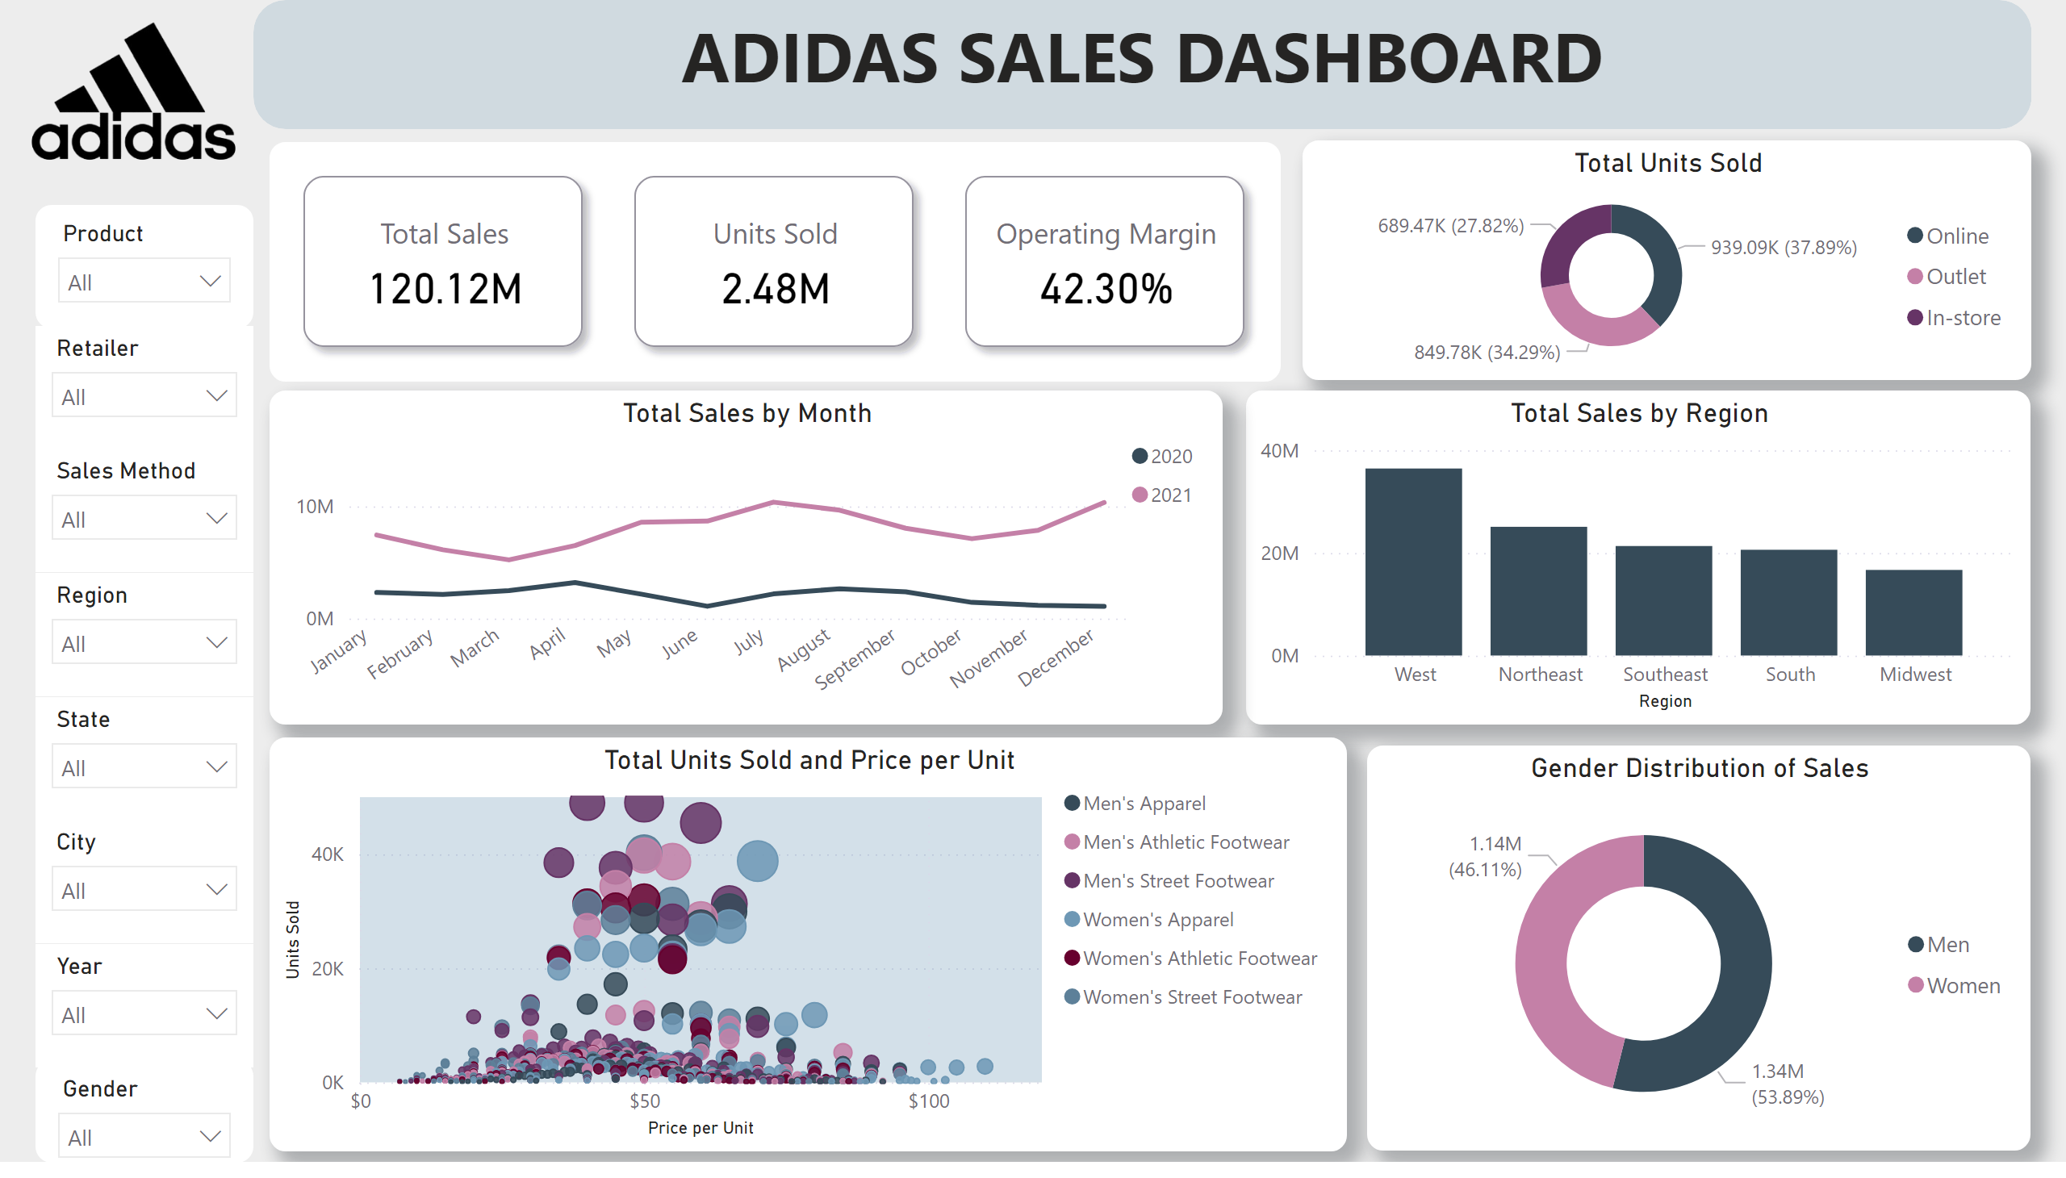
Customer & Market Insights
Notes:
slicer
No alt text provided
slicer
No alt text provided
slicer
No alt text provided
slicer
No alt text provided
slicer
No alt text provided
slicer
No alt text provided
slicer
No alt text provided
slicer
No alt text provided
cardVisual
No alt text provided
image
No alt text provided
shape
No alt text provided
textbox
No alt text provided
Total Units Sold
No alt text provided
Total Sales by Region
No alt text provided
Total Sales by Month
No alt text provided
Total Units Sold and Price per Unit
No alt text provided
Gender Distribution of Sales
No alt text provided

Slide 3
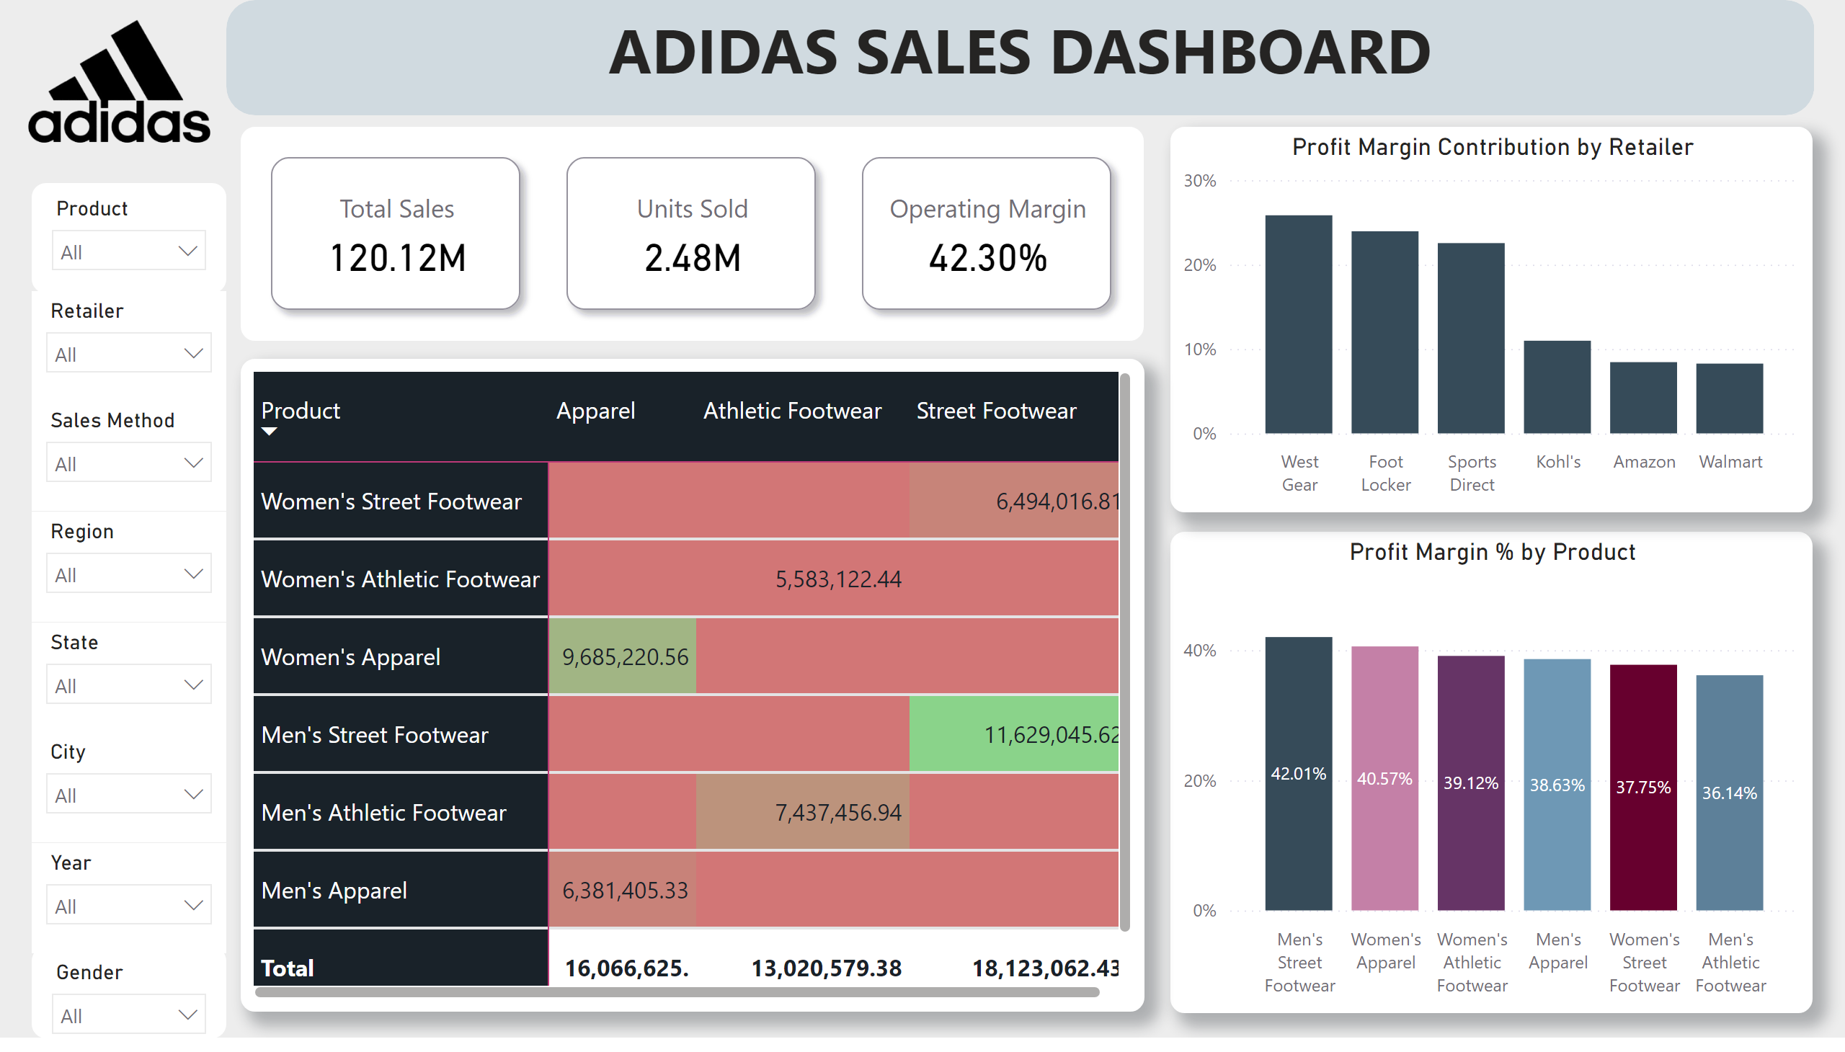
Profitablity & Margin
Notes:
slicer
No alt text provided
slicer
No alt text provided
slicer
No alt text provided
slicer
No alt text provided
slicer
No alt text provided
slicer
No alt text provided
slicer
No alt text provided
slicer
No alt text provided
cardVisual
No alt text provided
image
No alt text provided
shape
No alt text provided
textbox
No alt text provided
Profit Margin % by Product
No alt text provided
columnChart
No alt text provided
pivotTable
No alt text provided

Slide 4
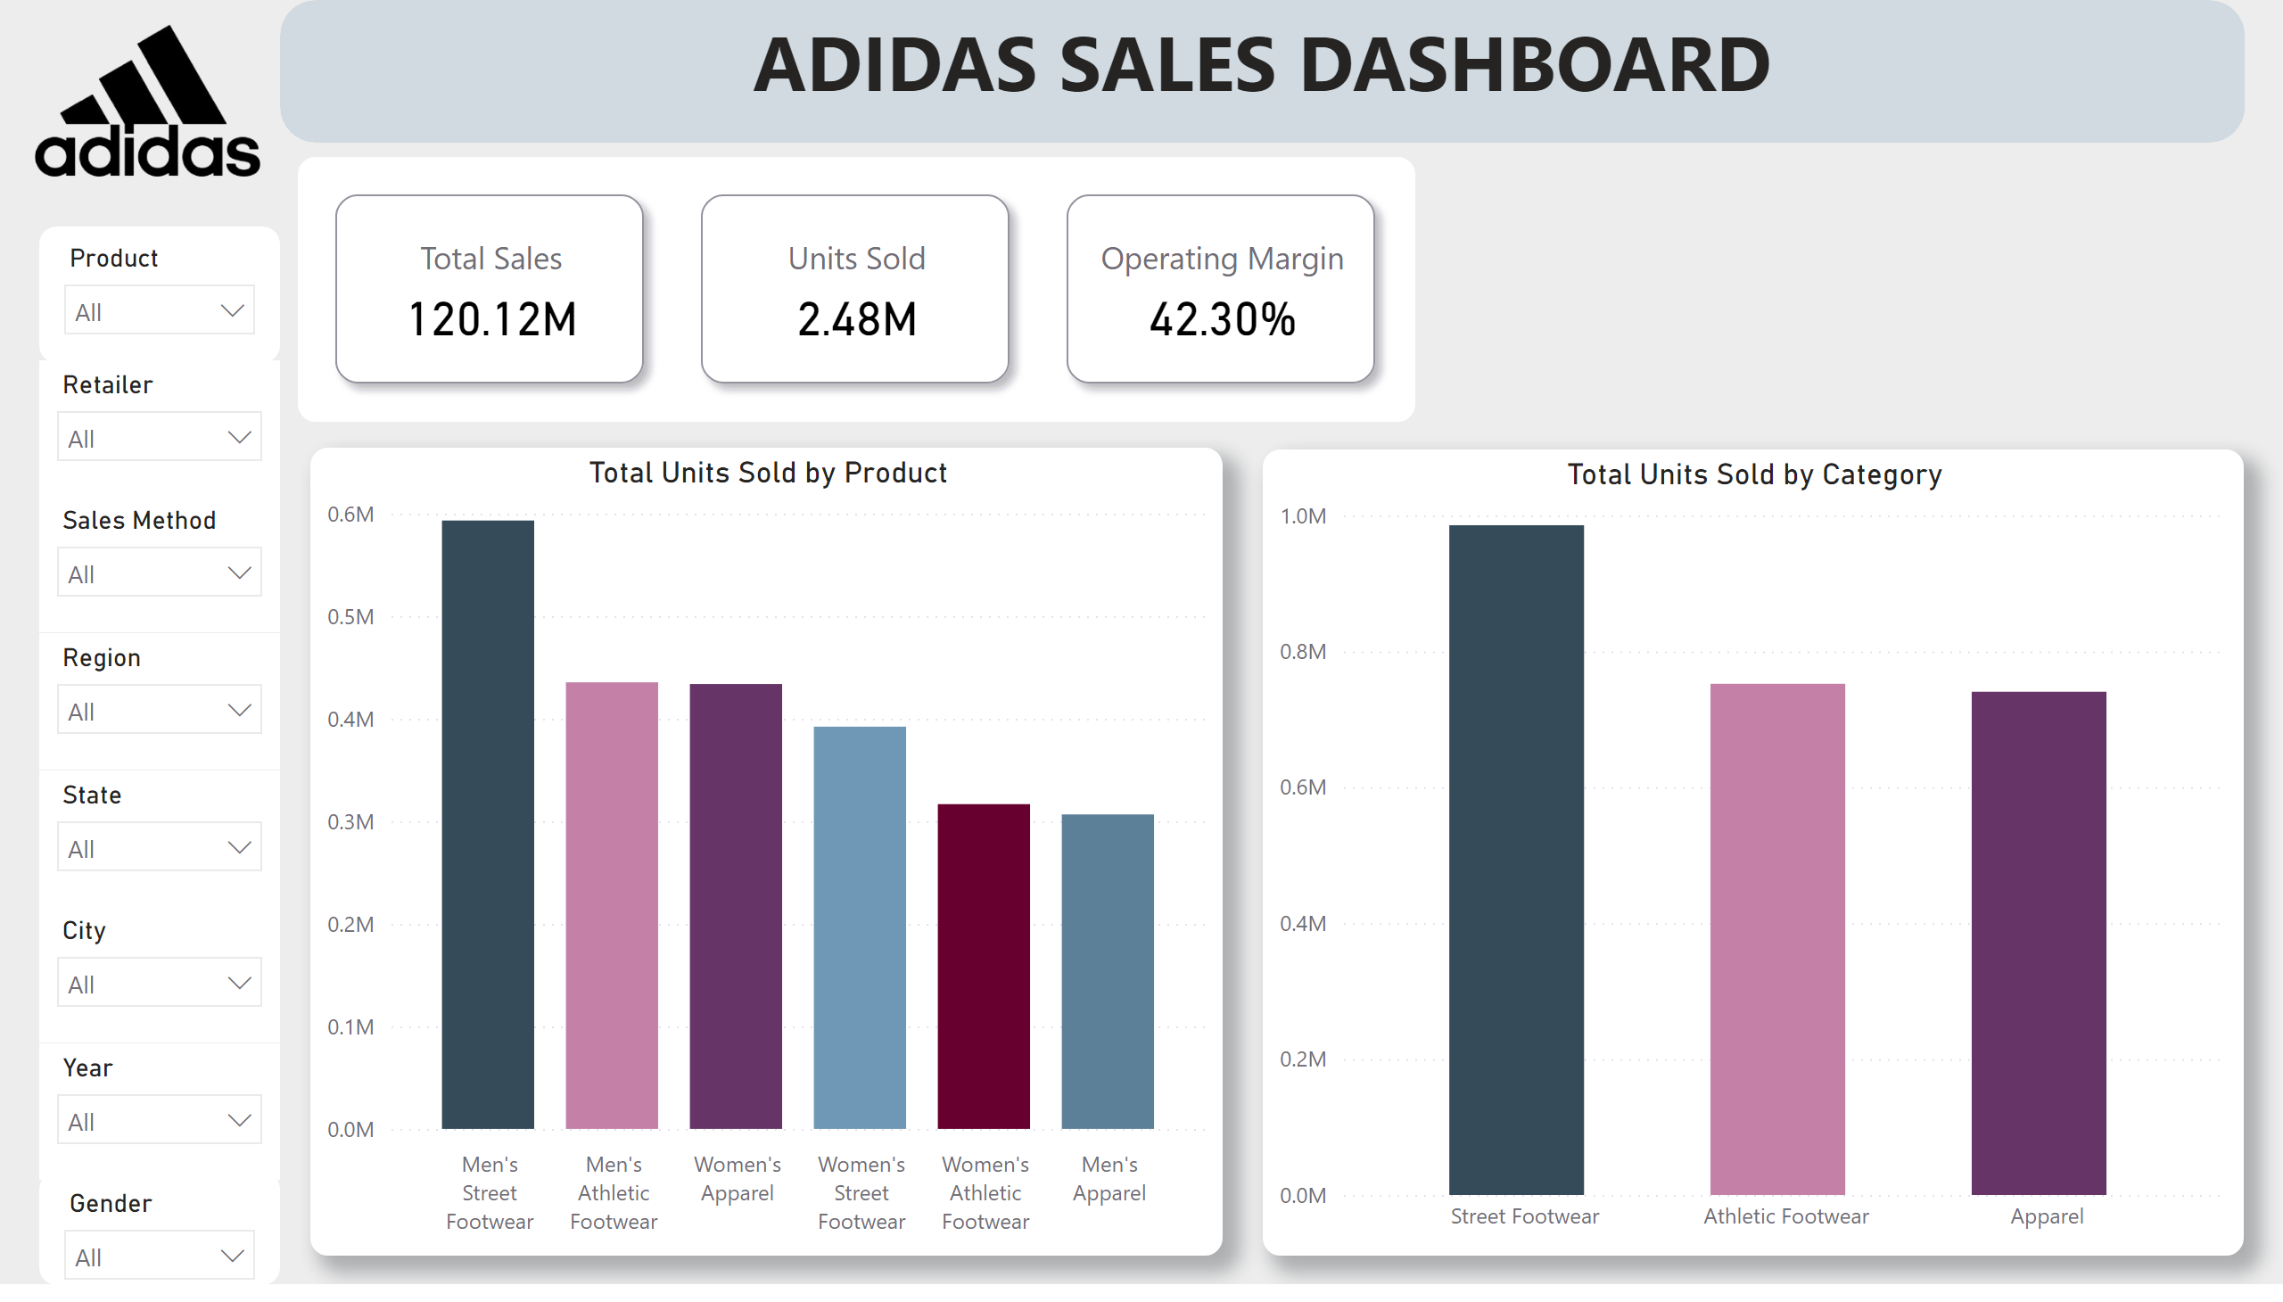
Demand Analysis
Notes:
slicer
No alt text provided
slicer
No alt text provided
slicer
No alt text provided
slicer
No alt text provided
slicer
No alt text provided
slicer
No alt text provided
slicer
No alt text provided
slicer
No alt text provided
cardVisual
No alt text provided
image
No alt text provided
shape
No alt text provided
textbox
No alt text provided
Total Units Sold by Product
No alt text provided
Total Units Sold by Category
No alt text provided

